Slide 1

Exploratory Data Analysis of Top 1000 Movies Dataset

Slide 2
Different Parameters of this Dataset:
Genre
Director
Runtime (in mins)
Rating (out of 10)
Revenue (in Millions)
Metascore (Critic Score, out of 100)
Year

Slide 3
How important a role do Directors play?

Slide 4
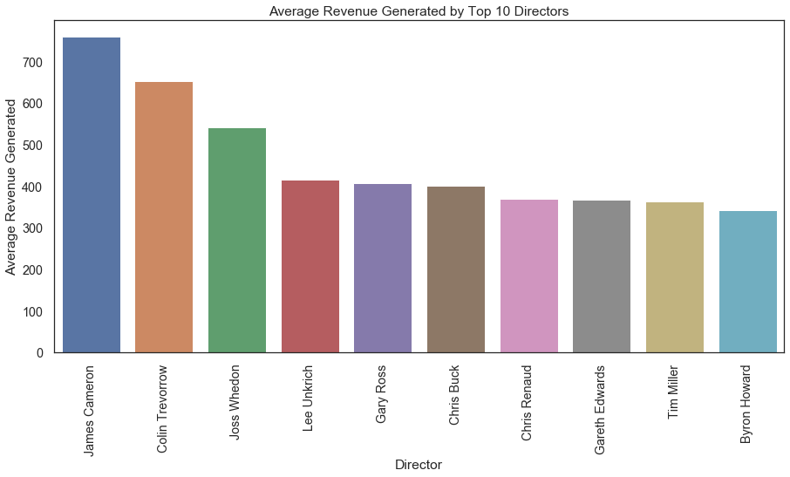
Top 10 Directors whose movies have earned High Revenues

Slide 5
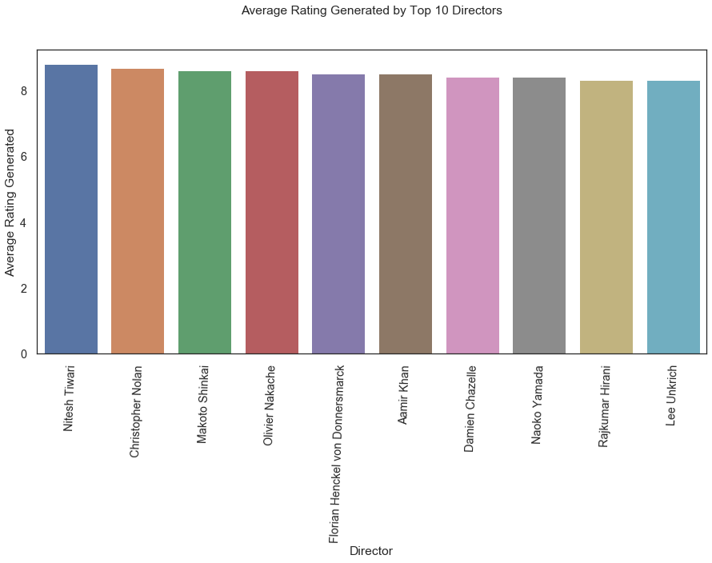
Top 10 Directors whose movies have earned High Ratings

Slide 6
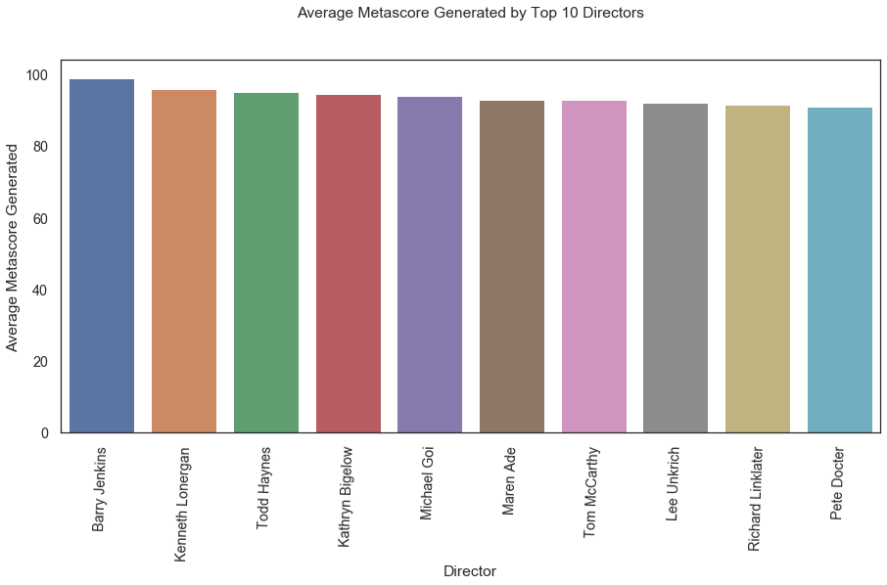
Top 10 Directors whose movies have earned High Critic Scores (Metascores)

Slide 7
How important a role does Runtime play?

Slide 8
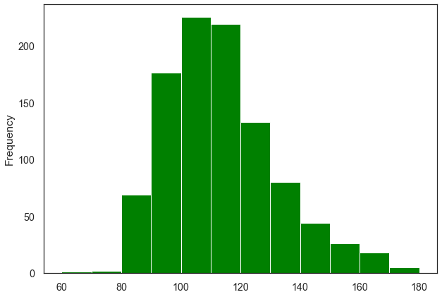
Distribution of Runtime of different movies
A major chunk of the movies have Runtime between 100 - 120 mins (Roughly between 25th and 75th percentile)

Slide 9
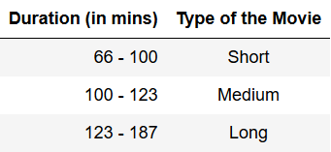
Since, the Runtime has a big range, Let's divide these times into SHORT, MEDIUM and LONG, for the sake of ease of study

Slide 10
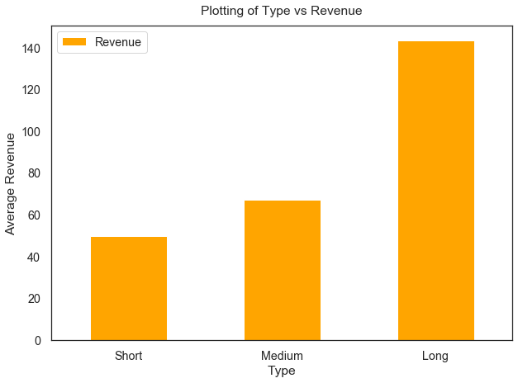
Which Runtime Interval earns higher revenue?

Slide 11
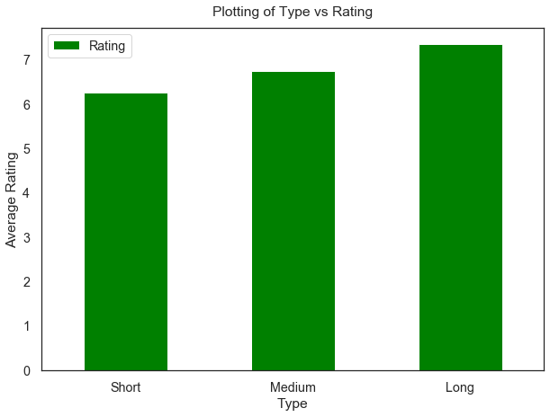
Which Runtime Interval earns higher ratings?

Slide 12
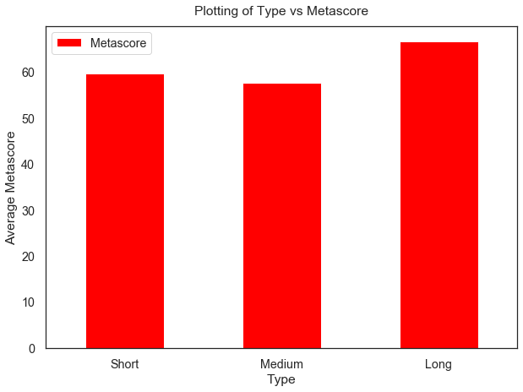
Which Runtime Interval earns higher Critic Ratings?

Slide 13
How important a role does Genre play?

Slide 14
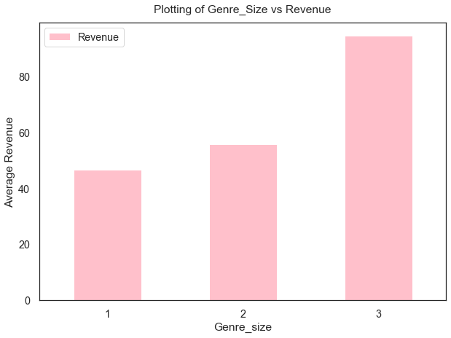
Which Genre Size earns more Revenue?

Slide 15
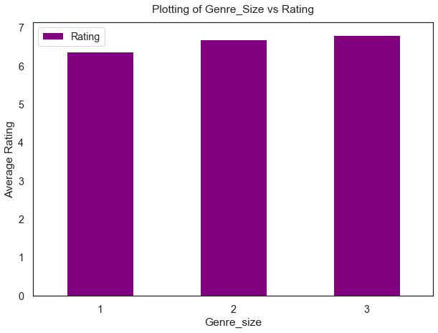
Which Genre Size earns more Rating?

Slide 16
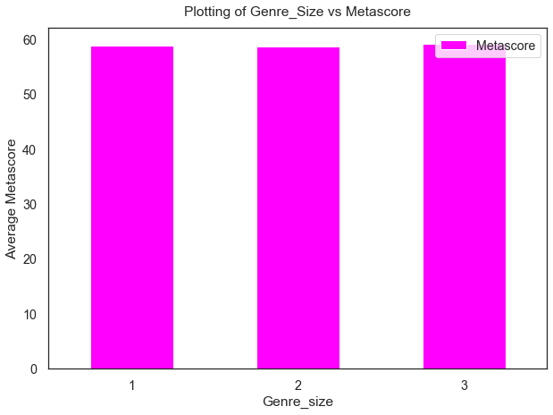
Which Genre Size earns more Metascore?

Slide 17
Observations:
Movies with 3 genre combinations do significantly better in terms of Revenue Generation.
But for Rating and Metascore, the difference is very subtle.

Slide 18
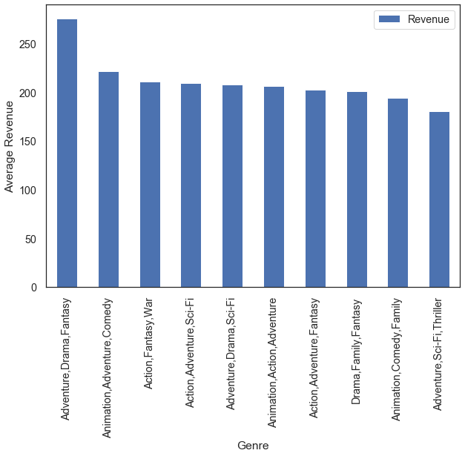
Which Genre combination is more popular?

Slide 19
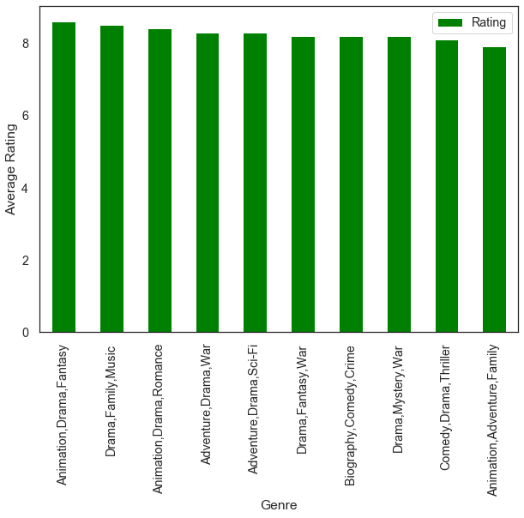
Which Genre combination is more popular?

Slide 20
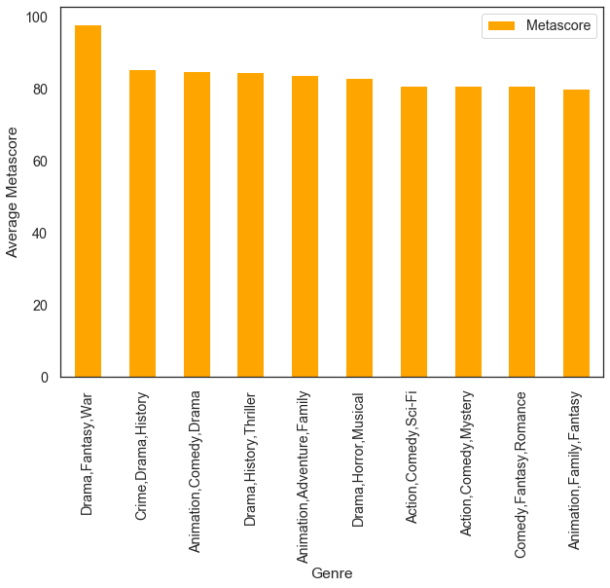
Which Genre combination is more popular?

Slide 21
Which directors make movies of popular genres?:
Adventure,Drama,Fantasy (Highest Revenue Earning Genre) : David Yates
Animation,Drama,Fantasy (Highest Rated Genre) : Makoto Shinkai
Drama,Fantasy,War (Highest Critically Acclaimed) : Guillermo del Toro

Slide 22
What has changed over the years?

Slide 23
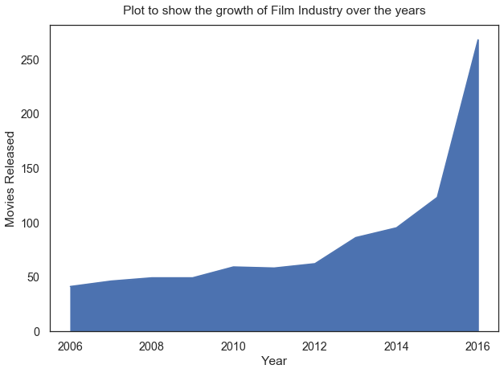
How has the movie industry changed over the years?
Movie production has significantly increased over the years, opening a new market of opportunities.

Slide 24
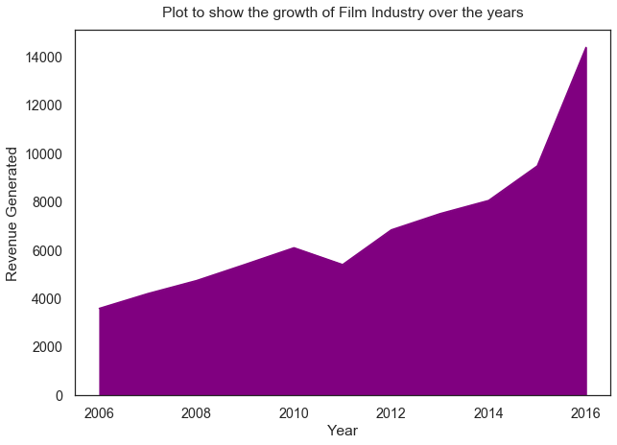
How has Revenue generation changed over the years in the industry?
The overall Revenue Generated has also increased with time which implies that this industry has grown with time and still has a promising future. And this attracts the investors.

Slide 25
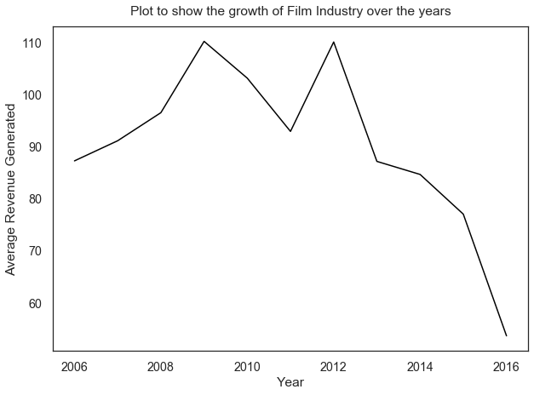
How has Average Revenue per movie changed over the years in the industry?
A very interesting pattern, the average revenue generated per movie has dramatically fallen down towards the end years. They have started falling from 2013 onwards.

Slide 26
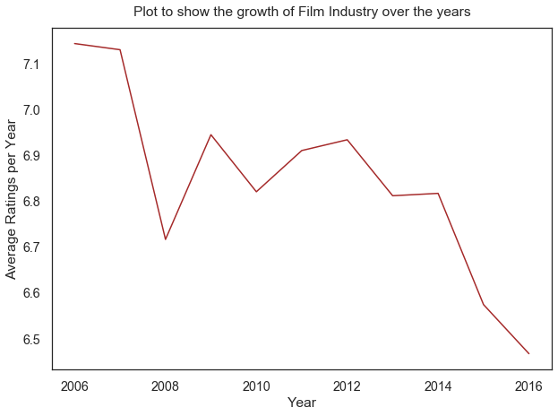
How has Average Rating pattern changed over the years in the industry?
The average rating per year is falling down dramatically just like Average Revenue.

Slide 27
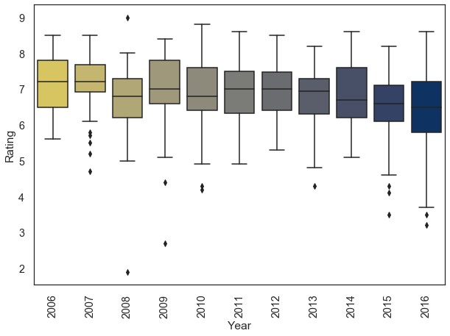
On further analysis...
The Average performance (rating 6.5/10) of 2016 movies has been worse than the rest. The average performances have been dropping from 2013 onwards.

Slide 28
Why are movies doing bad?

Slide 29
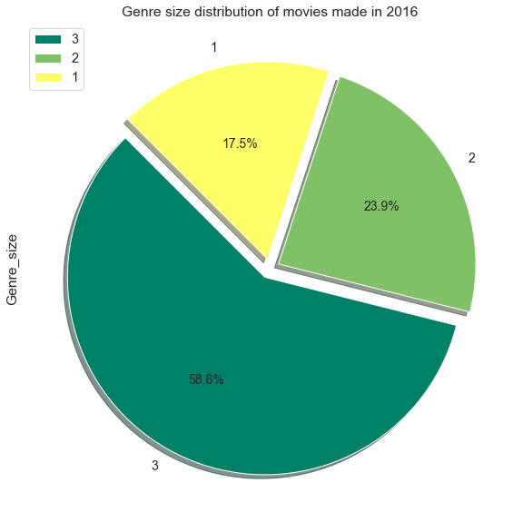
Analysing the genre_size of movies of 2016...
58.6% movies have genre_size 3. We already know from our findings, genre_size 3 generates the most revenue, better ratings and are critically well acclaimed.

Slide 30
Analysing the genre of movies of 2016...
As we had found out:
Adventure,Drama,Fantasy : the combination producing the highest Revenue
Animation,Drama,Fantasy : the combination producing the highest Rating
Drama,Fantasy,War : the combination producing the highest Critic Score
But in the year 2016, the number of movies made in these genres is as follows:
Adventure,Drama,Fantasy : 0
Animation,Drama,Fantasy : 1
Drama,Fantasy,War : 0
This was a very big opportunity that the movie makers had missed out on. Genre combinations that could potentially earn high Revenues and Rating and Critics Scores were not focused on.

Slide 31
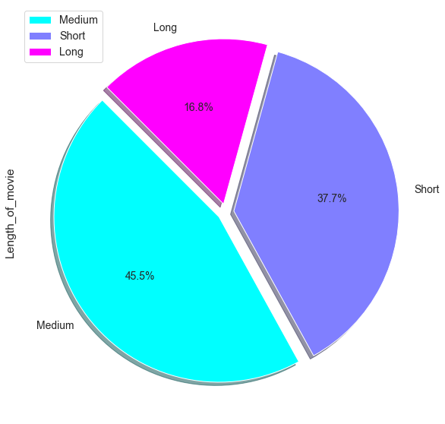
Analysing the Runtime of movies of 2016...
In 2016, only 16.8% movies were of long duration. This was an opportunity missed.

Slide 32
Analysing the Directors of movies of 2016...
The directors of 2016 movies are not among the top 5 names found in reference with high Revenue.
The Average Ratings given in 2016 is the lowest (6.46) in 10 years, but we do have some movies made by well rated directors like - Christopher Nolan, Olivier Nakache and Makoto Shinkai.
The movies in 2016 have done decently well in terms of critic scores.

Slide 33
Conclusion...

Slide 34
Conclusion...
The Best directors :
James Cameron : Revenue
Christopher Nolan : Rating
Barry Jenkins : Metascore
None of these top ranking directors made movies in 2016.
2. Long duration movies (> 123 mins) did very well in terms of Revenue, Ratings and Metascore.
But, only 16.8% long movies were made in 2016
3. As the genre size (numbers of genres present in a movie) increased, the Rating, Revenue and Metascore increased.
4. The industry's growth is very promising. It has grown around 15% in 10 years timeframe (from 2006 to 2016).

Slide 35
Conclusion...
5. Average Revenue and Average Rating (Popularity) of movies have shown a
Negative Trend.
6. Rating and Metascore are highly correlated. Movies with high Ratings and
Metascore have also earned high Revenue.

Slide 36
Actionable Insights...

Slide 37
Actionable Insights...
Movies made by well acclaimed directors will bring in more Revenue, better Ratings and Metascore.
Long movies ( >123 mins) have better Ratings, Metascore and high Revenues.
Movies with 3 Genre combination have been very well acclaimed.
Movies that are audience and critics pleasing, earn more Revenue.

Slide 38
Thank You!

